Slide 1
Synthesis and Characterization of N-Doped Carbon Nanoribbons
John Glauber
Miguel Angel Ibarra
Michael Kummer
Advisor: Jessica Campos-Delgado

Slide 2
Purpose
To alter the physical and electrical properties of carbon nanoribbons by in-situ CVD nitrogen doping.
To detect substitutional doping in the carbon lattice or at the edges with the use of:
Raman Spectroscopy
XRD
EDX

Slide 3
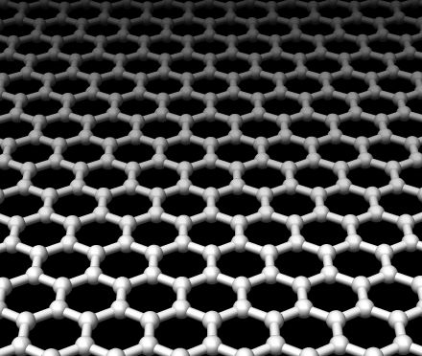
Importance of Graphene
Single sheets of sp² bonded carbon atoms in hexagonal lattice
Zero-gap semiconductor – between a metal and a semiconductor
Spin orbit interaction – spin interacts with motion
http://math.ucr.edu/home/baez/graphene.jpg

Slide 4
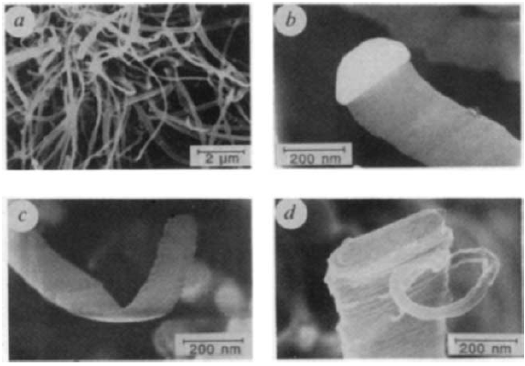
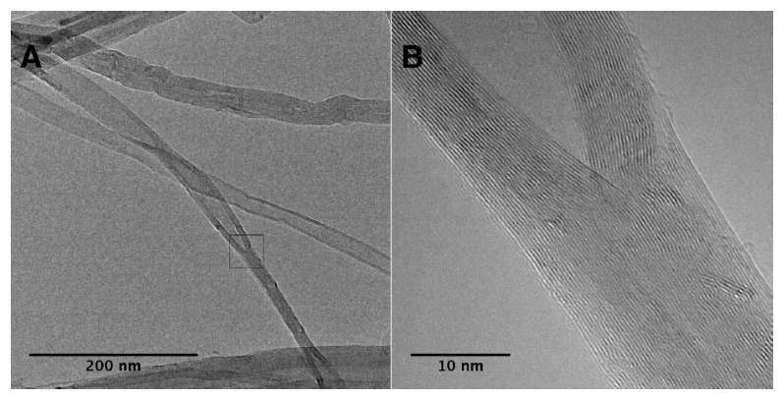
Review of Literature: Carbon Nanoribbons
Murayama, H. et al. (1990)
Disproportionation of carbonmonoxide
Carbon monoxide / Hydrogen gas flow with Fe(CO)5
Iron carbides serve as catalysts. Growth occurs from tips.
50 vol% products are ribbon filaments produced
86% degree of graphitization
Ribbon layers form perpendicular to axis of growth as long as 10µm
Cano-Márquez, Abraham G. et al. (2009)
Intercalation and Exfoliation
Open ended MWCNTs intercalated by Li ion solution in NH₃
Exfoliated with HCl
Yields ~60% possible
SEM images of graphite ribbon filaments. The iron catalyst can be observed at the tip. Murayama, H. et al.
TEM images of intercalated MWCNT. Cano-Márquez, Abraham G. et al.

Slide 5
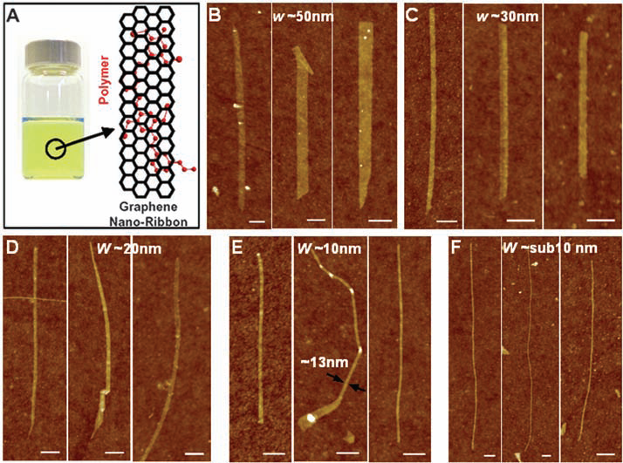
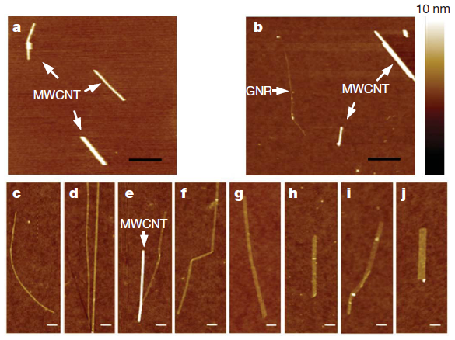
Review of Literature: Carbon Nanoribbons
Li, Xiaolin et al. (2009)
Chemical exfoliation
Bulk graphite
60s heating to 1000°C in 3% Ar-H
30 min sonication DCE and PmPV
Analysis with AFM
Produced graphene nanoribbons (GNR) sub-10 nm widths
Jiao, Liying et al. (2009)
Unzipping carbon nanotubes
Argon Plasma etching of MWCNTs
Immerse MWCNTs in PMMA as a protective layer
10W Ar plasma longitudinally etches
10s etching - 20% yield, 10-20 nm width, 2 nm thickness
Longer etching times single / few layer GNRs
AFM images of chemically exfoliated GNRs. Li, Xiaolin et al.
AFM images of plasma etched carbon nanoribbons. Jiao, Living et al.

Slide 6
Review of Literature: Carbon Nanoribbons
Kosynkin, Dmitry V. et al. (2009)
Unzipping by solution oxidation
Suspend MWCNTs in H₂SO₄ and treated with KMnO₄
80-100% of MWCNTs form nanoribbons
Higher degrees of oxidation with more oxidizing agents
Computer rendering of the unzipping of a single layer of a MWCNT. Kosynkin, Dmitry V. et al.

Slide 7
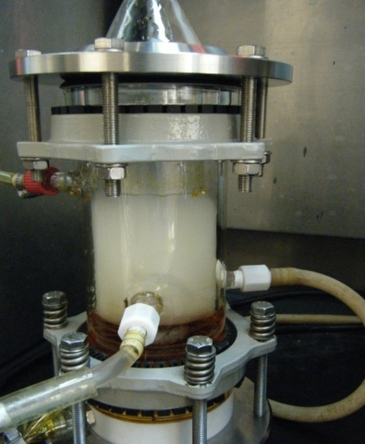
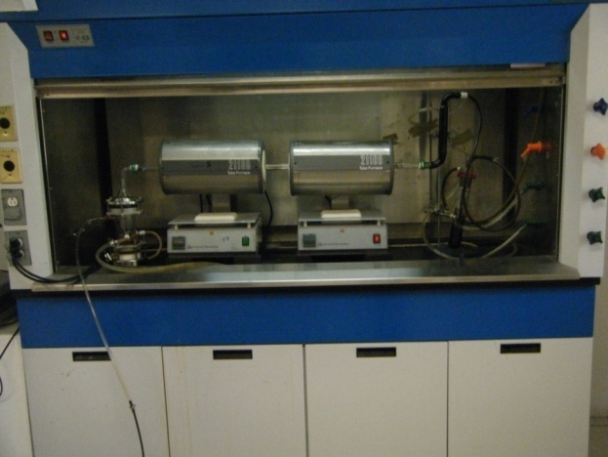
Method
Chemical Vapor Deposition Pyrolysis
Solution Preparation:
280 ml (98.625 wt%) Ethanol
2.8035 g (1.25 wt%) Ferrocene
266 µL (0.125 wt%) Thiophene
Furnace Temperature:
950°C
Flux Rates:
Heat/Cool: 0.2 L/min
Synthesis: 0.8 L/min
Ultrasonic Generator:
Wavelength: 590
Frequency: 568
Synthesis Duration:
30min

Slide 8
SEM Characterization
SEM images of pristine carbon nanoribbons synthesized by the CVD pyrolysis process

Slide 9
Evidence of fiber and tube growth in pristine carbon nanoribbon sample.

Slide 10
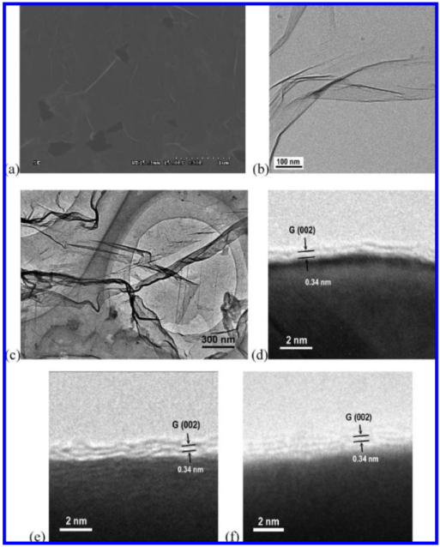
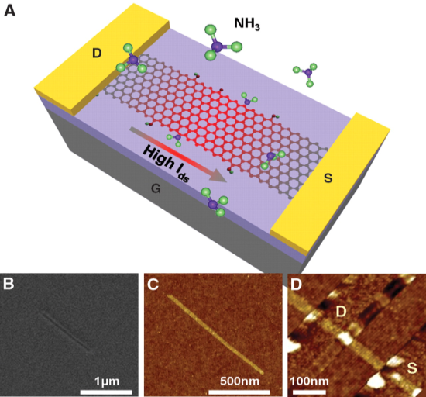
Review of Literature: N-Doped Nanoribbons
Wei, Dacheng et al. (2009)
CVD synthesis
Cu film on Si substrate used as catalyst
Ar/H flow during heating
CH₄ and NH₃ flow for 10min of synthesis.
Cooled in H₂ environment
Produced few layer graphene
Nitrogen substituted into lattice
Pyrrolic and pyridinic N atoms detected
Wang, Xinran et al. (2009)
Electrical annealing in NH₃ environment
High vacuum environment
N doping occurs at edges with C atom being substituted
Clear N signal detected by XPS
P- and N-doping due to oxygen functionalization
SEM and TEM images of nitrogen doped graphene. Wei, Dacheng et al.
SEM and AFM images of FET e-annealed GNR device. Wang, Xinran et al.

Slide 11
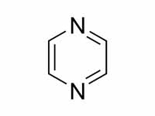
Physical Properties
Pyrazine
Molecular Formula | C₄H₄N₂
Molar Mass | 80.09 g/mol
Appearance | White crystals
Density | 1.031 g/cm³
Melting point | 52 °C
Boiling point | 115 °C
Solubility in water | Soluble
Adapted from: http://en.wikipedia.org

Slide 12
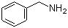
Physical Properties
Benzylamine
Molecular Formula | C₇H₉N
Molar Mass | 107.15 g mol⁻¹
Appearance | Colorless liquid
Density | 0.981 g/mL
Melting Point | -30 °C (22°F)
Boiling Point | 183 °C (361.4°F)
Solubility in water | 3.24 g / 100 g water @ 25 °C
Solubility in methanol | methanol 9.16 M
Adapted from: http://en.wikipedia.org

Slide 13
Method of Production: In-Situ N-Doped nanoribbons
Pyrazine (C₄H₄N₂)
Pyrazine Concentration (wt %) | 0.125 | 1 | 3
Ferrocene Concentration (wt %) | 1.25 | 1.25 | 1.25
Thiophene Concentration (wt %) | 0.125 | 0.125 | 0.125
Furnace Temperature (°C) | 950 | 950 | 950
Synthesis Duration (min) | 30 | 30 | 30
Argon Flux Rates (L/min) | Purge: 0.2 L/min Synthesis: 0.8 L/min | Purge: 0.2 L/min Synthesis: 0.8 L/min | Purge: 0.2 L/min Synthesis: 0.8 L/min

Slide 14
Method of Production: In-Situ N-Doped nanoribbons
Benzylamine (C₇H₉N)
Benzylamine Concentration (wt %) | 3 | 5 | 10
Ferrocene Concentration (wt %) | 1.25 | 1.25 | 1.25
Thiophene Concentration (wt %) | 0.125 | 0.125 | 0.125
Furnace Temperature (°C) | 950 | 950 | 950
Synthesis Duration (min) | 30 | 30 | 30
Argon Flux Rates (L/min) | Purge: 0.2 L/min Synthesis: 0.8 L/min | Purge: 0.2 L/min Synthesis: 0.8 L/min | Purge: 0.2 L/min Synthesis: 0.8 L/min

Slide 15
Characterization Methods
SEM
TEM
XRD
Raman
PPMS

Slide 16
SEM
0.125% Pyrazine; 1.0% Pyrazine; 3.0% Pyrazine

Slide 17
0.125 wt% Pyrazine
SEM images of carbon nanoribbons doped with 0.125 wt% pyrazine.

Slide 19
1.0 wt% Pyrazine
SEM images of carbon nanoribbons doped with 1.0 wt% pyrazine. Higher concentrations of worm and tube growth are apparent.

Slide 20
3.0 wt% Pyrazine
SEM images of carbon nanoribbons doped with 3.0 wt% pyrazine. Higher concentrations of tube and fiber growth are apparent.

Slide 21
SEM
3.0 wt% Benzylamine, 5.0 wt% Benzylamine, 10.0 wt% Benzylamine

Slide 22
3.0 wt% Benzylamine
SEM images of carbon nanoribbons doped with 3.0 wt% benzylamine.

Slide 23
5.0 wt% Benzylamine
SEM images of carbon nanoribbons doped with 5.0 wt% benzylamine. Evidence of carbonaceous growth can be detected.

Slide 24
5.0% Benzylamine EDX distribution of number of counts as a function of energy (eV). No evidence of nitrogen was detected. XL-30 SEM was used to collect data.

Slide 25
10.0 wt% Benzylamine
SEM images of carbon nanoribbons doped with 10.0 wt% benzylamine. Evidence of fibers and carbonaceous growth can be detected.

Slide 26
TEM
3% Pyrazine

Slide 27
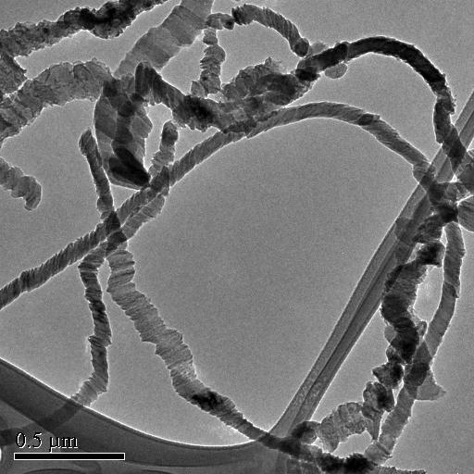
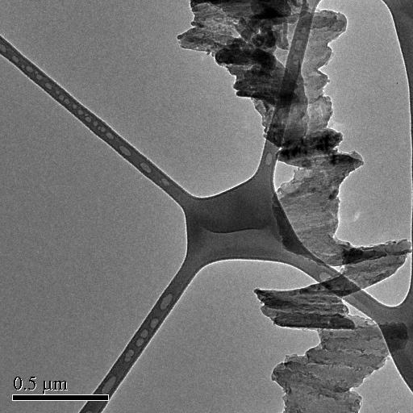
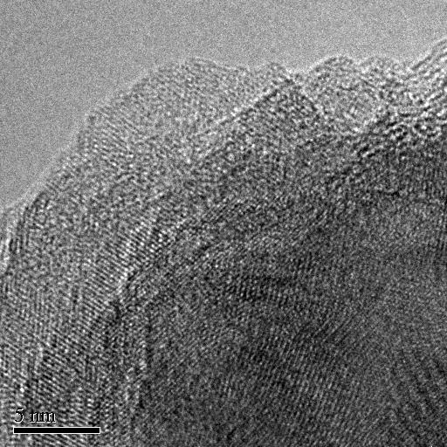
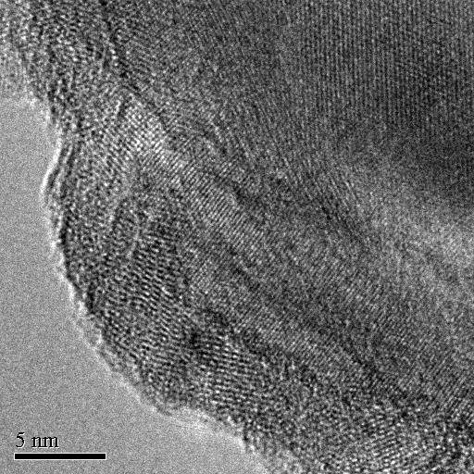
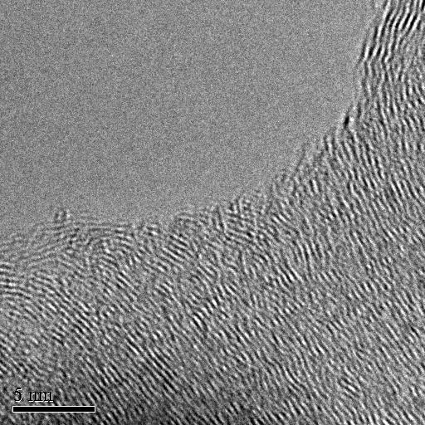
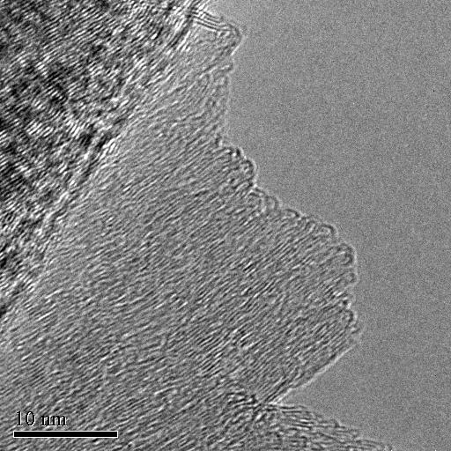

Slide 28
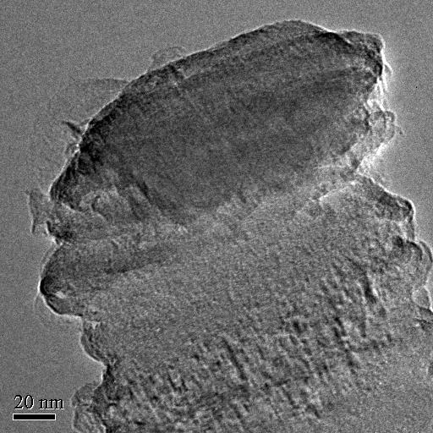
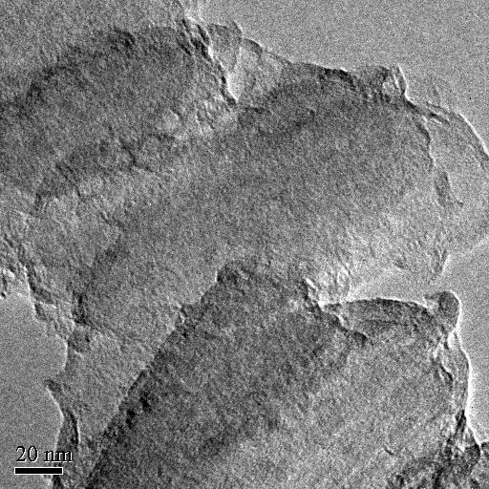
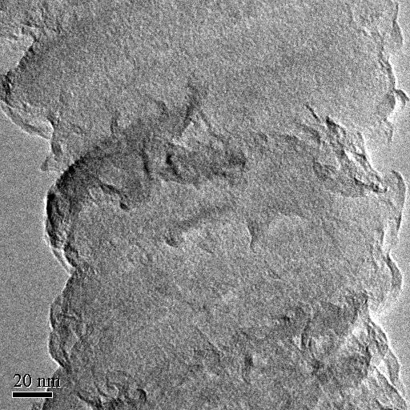
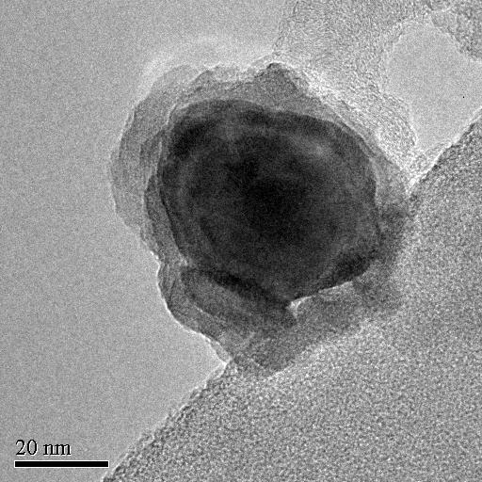
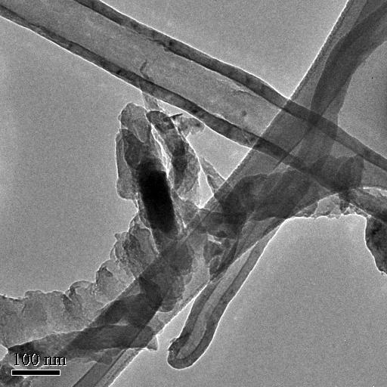
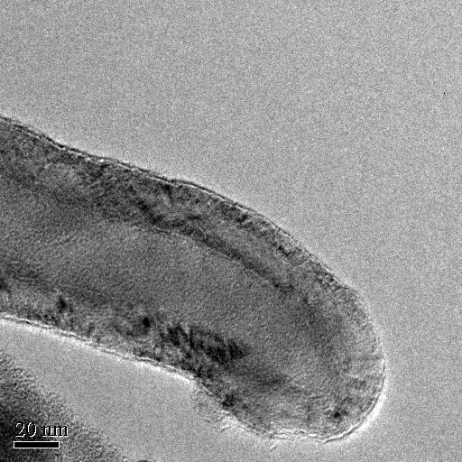

Slide 29
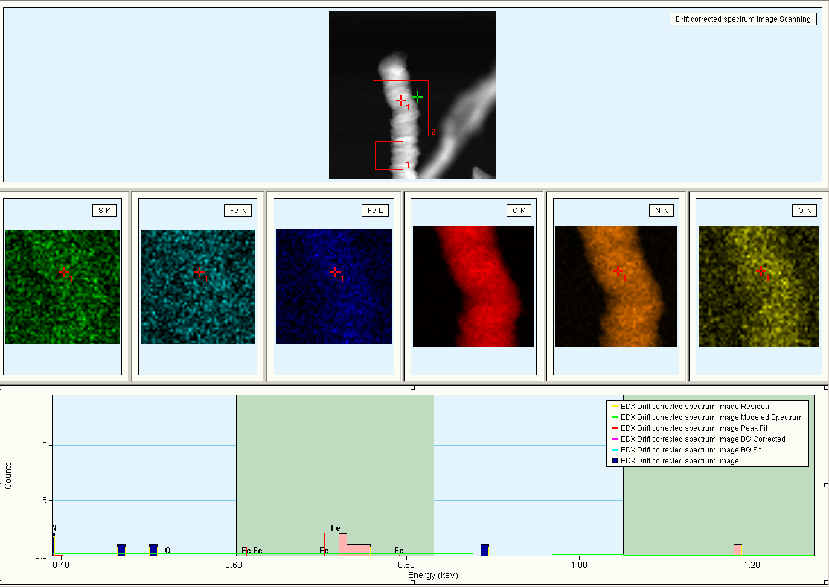
EDX Line Scan of 3% Pyrazine

Slide 30
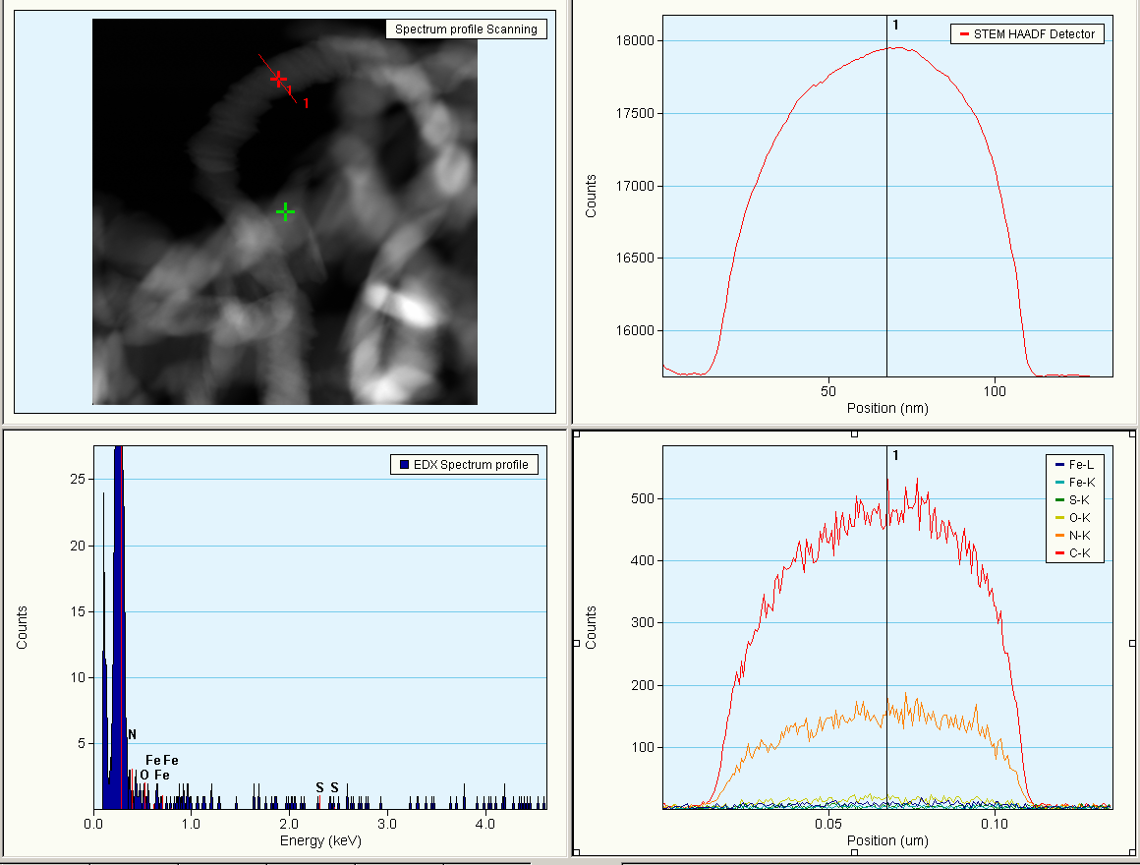
EDX Line Scan of 3% Pyrazine

Slide 31
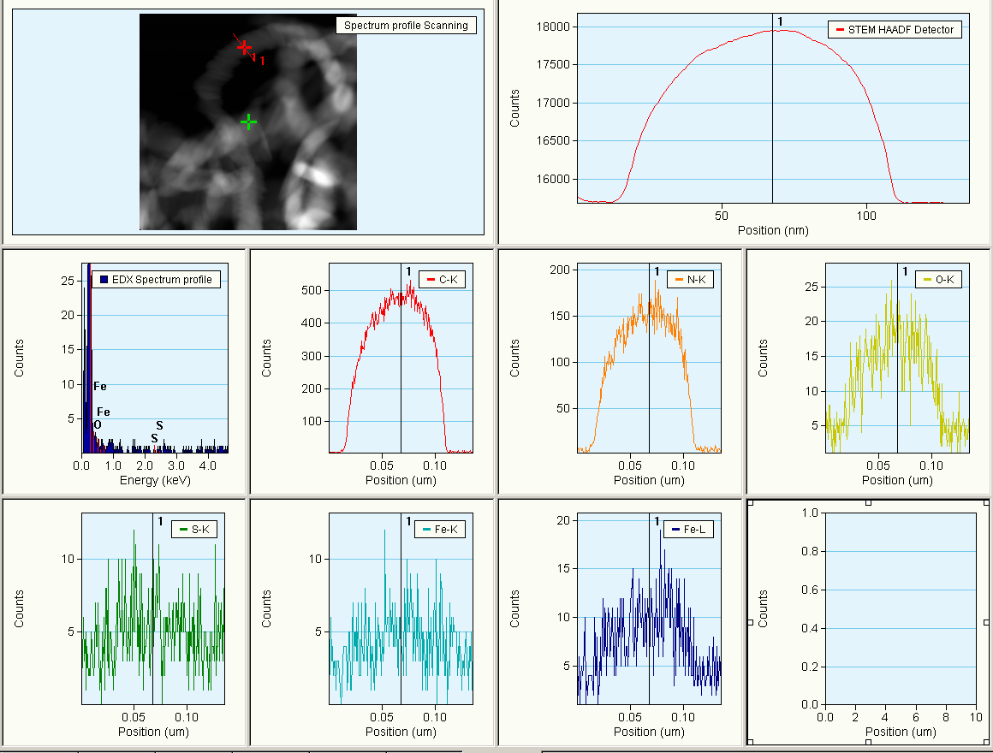
EDX Line Scan of 3% Pyrazine

Slide 32
XRD
Pristine; 0.125%, 1.0%, 3.0% Pyrazine; 3.0%, 5.0%, 10.0% Benzylamine

Slide 33
Bragg’s Law: nλ=2d sin(θ)
Normalized graphs of intensity as a function of angle for x-ray diffraction with pristine and nitrogen doped carbon nanoribbons. The graph on the right shows a close up of the 002 peak.

Slide 34
Spacing Between Graphitic Planes
Sample | d spacing (Å)
Pristine | 3.400
Pyrazine 0.125% | 3.393
Pyrazine 1.0% | 3.381
Pyrazine 3.0% | 3.375
Benzylamine 3.0% | 3.392
Benzylamine 5.0% | 3.383
Benzylamine 10.0% | 3.381
NOTE: All d spacing values were determined by averaging data from the first and second order peaks. The wavelength of the x-rays was 1.54 Å.

Slide 35
Raman
Pristine; 0.125% Pyrazine; 1.0% Pyrazine; 3.0% Pyrazine; 3.0% Benzylamine; 5.0% Benzylamine

Slide 40
D and G Band Intensity Ratio
Sample | I_{D}/I_{G}
Pristine | 0.897
Pyrazine 0.125% | 1.061
Pyrazine 1.0% | 0.872
Pyrazine 3.0% | 1.057
Benzylamine 3.0% | 0.960
Benzylaminne 5.0% | 0.914

Slide 41
D and G Band Intensity Ratio

Slide 42
PPMS
Pristine

Slide 43
Resistivity as a function of magnetic field for the dark side of a pristine carbon nanoribbons.
Resistivity as a function of magnetic field for the shiny side of a pristine carbon nanoribbons.
Resistivity as a function of temperature for the dark side of a pristine carbon nanoribbons.
Resistivity as a function of temperature for the shiny side of a pristine carbon nanoribbons.

Slide 44
Future Work
Conduct further trials to determine ideal concentration for doping
Additional characterization to search for evidence of N-doping
Electron Diffraction
Thermogravimetric Analysis (TGA)
X-ray Photoelectron Spectroscopy (XPS)
Electron Energy Loss Spectroscopy (EELS)

Slide 45
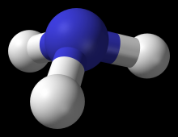
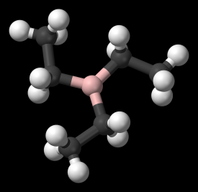
Future Work
Post synthesis treatment:
Ammonia (NH₃)
Boron Doping:
TEB

Slide 46
SEM
0.125 wt% Triethylborane, 1.0 wt% Triethylborane

Slide 47
0.125 wt% Triethylborane
SEM images of carbon nanoribbons doped with 0.125 wt% triethylborane.

Slide 48
0.125 wt% Triethylborane
SEM images of carbon nanoribbons doped with 0.125 wt% triethylborane.

Slide 49
0.125 wt% Triethylborane
SEM images of carbon nanoribbons doped with 0.125 wt% triethylborane. Evidence of tube and fiber growth.

Slide 50
1.0 wt% Triethylborane
SEM images of carbon nanoribbons doped with 1.0 wt% triethylborane.

Slide 51
1.0 wt% Triethylborane
SEM images of carbon nanoribbons doped with 1.0 wt% triethylborane.

Slide 52


Acknowledgements
Prof. M. Terrones; Prof. H. Terrones; Prof. P. Ajayan; Prof. E. Muñoz; D. Ramirez; H. Martínez; S. Vega; A. Morelos; V. Gonzalez; A. Botello; Rice University; IPICYT

Slide 53
Works Cited
Hongjie Dai et al. “Chemically Derived, Ultrasmooth Graphene Nanoribbon Semiconductors.” Science 29 Feb 2008: vol. 19, 1229-1231
Jiao, Liying et al. “Narrow graphene nanoribbons from carbon nanotubes.” Nature 16 April 2009: vol. 458, 877-880
Cano-Márquez, Abraham G. et al. “Ex-MWNTs: Graphene Sheets and Ribbons Produced by Lithium Intercalation and Exfoliation of Carbon Nanotubes” Nano Letters 2009: vol. 9, no. 4, 1527-1533
Kosynkin, Dmitry V. et al. “Longitudinal unzipping of carbon nanotubes to form graphene nanoribbons” Nature 16 April 2009: vol. 458, 872-876
Murayama, H. and T. Maeda “A novel form of filamentous graphite” Nature 28 June 1990: vol. 345, 791-793
Wei, Dacheng et al. “Synthesis of N-Doped Graphene by Chemical Vapor Deposition and its Electrical Properties” Nano Letters 2009: Vol. 9. no. 5, 1752-1758
Wang, Xinran et al. “N-doping of Graphene through Electrochemical Reactions with Ammonia” Science 8 May 2009: Vol. 324. no. 5928, 768 - 771

